Slide 1




PHD Progression 4
Explainable AI with visual analytics

Slide 2
AttentionVIZ
AttentionVIZ GitHub repo found and forked
The documents have been downloaded, and I will now be playing around with it
Some important component for this to work are missing the WEB document

Slide 3
How Transformers Learn Causal Structure with Gradient descent
Self-attention allows transformers to encode causal structures
Prior work shows that in context learning relies on the existence of specific circuits called induction heads

Slide 4
Experiment
This research focuses on two-layer transformer architecture(causal self-attention layer)
The experimental model is similar decoder-based attention-only transformers
They feed the model random seq with causal structure

Slide 5
Layer one( half of induction head)
In the first attention layer the causal map is developed, an attention weight matrix which mirrors the hidden structure of the mapped data sequence
The connections light up if a token is influenced by another, a process called mutual information

Slide 6
Layer two(second half of induction head)
uses the known map to perform the specific calculation needed for the task
estimating the empirical transmission distribution

Slide 7
Layer three( half of induction head)
averages the calculation done in the second layer
this is the empirical transmission matrix, and where our prediction is made

Slide 8
Gaps in research
what happens if the model is introduced to non-causal structures, cyclical structures, and feedback loops.

Slide 9
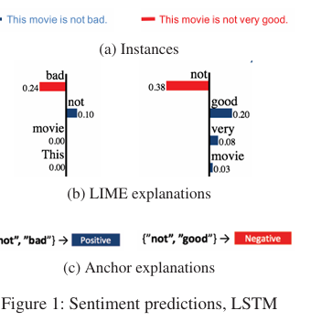
Anchors: High-Precision Model-Agnostic Explanations
f : X → Y
x ∈ X instance
Most model agnostic methods work by perturbing the instance x, according to some perturbation distribution of Dx.

Slide 10
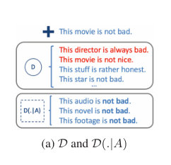
Anchors: High-Precision Model-Agnostic Explanations
A is an anchor if A(x) = 1 and A is a sufficient condition for f(x) with high probability
If a sample D(z|A) is likely to predict positive (i.e f(x) = f(z))

Slide 11
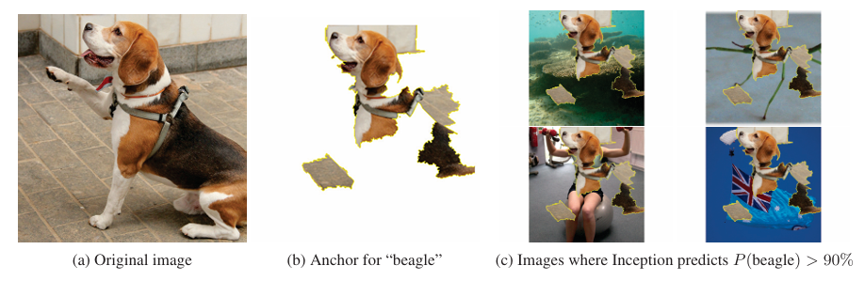
Anchors: High-Precision Model-Agnostic Explanations
A is an anchor if ED(z|A)[1f(x)=f(z)] ≥ τ,A(x)=1.
Anchors are faithful over larger coverages
Anchors can capture nonlinear relationships, even locally

Slide 12
Approaches for constructing anchors
Bottom-up approach and Beam-search
Beam-search approach is preferred as the prior approach only maintains a single rule at a time, and bottom-up approach does not prioritize coverage

Slide 13
Experiment
models, logistic regression, 400 gradient boosted trees, and multilayer perceptron with two layers of 50 units each
Both linear LIME and anchor were used to explain them
The experiment compared instances of explainability, asking users to make predictions without an explanation

Slide 14
Experiment results
The precision, coverage, and time taken to learn the explainability was recorded
it showed that anchors are much more efficient at explaining the model predictions

Slide 15
Limitations and future use
Overly specific anchors
Potentially conflicting anchors
Complex output spaces
Realistic perturbation distributions

Slide 16
ExplAIner: A Visual Analytics Framework for interactive and explainable Machine
This research focuses on interactive machine learning with explainable visual analytics
ExplAIner is a framework that operationalizes the theoretical workflow and concepts of XAI models in a system implementation

Slide 17
ExplAIner: A Visual Analytics Framework for interactive and explainable Machine
It is integrated on Tensor Board (TB)
provides interactive exploration of the model graph, on-demand aggregation and visualization of performance metrics
integration of high-level explainers like LIME and LRP

Slide 18
ExplAIner: A Visual Analytics Framework for interactive and explainable Machine
The pipeline is built around the tasks of understanding, diagnosis and refining
Explainers are the main building blocks of the framework

